Slide 1

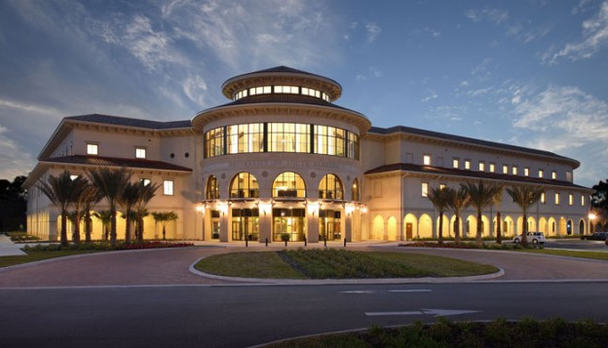
Week- 12 Sprint Review (Showcase) and Sprint Retrospective Dr. Bhuvan UNHELKAR IT Faculty, College Of Business; Office: C225; bunhelkar@sar.usf.edu; 941-359-4654

Slide 2

Agenda
Quick Recap of Agile Practices (Techniques) – 13
Showcasing in Agile/Scrum
And its position in Scrum Review
Retrospective in Agile/Scrum
Summary & Consolidation

Slide 3
Job Aids for Agile Practices (Aligned with CAMS)
[1] User Story (Features)
[2] User Persona
[7] Iteration Planning
[3] Prioritization (MoSCoW)
[10] Show Casing
[4] Estimation
[6] Capability Analysis
CAMS
Pre-Iteration
Post-Iteration
[8] Visible Charting
[9] Backlog Management
[11] Retrospective
[5] Team Formation
[12] Continuous Testing
[13] Daily Stand-up Meeting
Core – Within Iteration
Notes:
We will learn and use these Agile Practices throughout the Course. We will open relevant Job Cards to remind us of the practices.
CAMS – stands for Composite Agile Method and Strategy – and is described in greater detail on Day 2.

Slide 4

Sub-Module Showcasing
An Agile Practice (part of Sprint Review)
© MethodScience; Material Designed and Presented by Dr. B. Unhelkar; drawn from The Art of Agile Practice

Slide 5
Showcasing…
This is a DEMONSTRATION of the Solution at the end of a Sprint
Having a Working Solution throughout the project is integral to Agile approaches
Continuous Testing is part of having a Working Solution (that works!)
Only a “Potentially Shippable” product-slice is showcased
NO Powerpoint; NO concepts (theory)

Slide 6
Organizing a Showcase
Product Owner invites key Stakeholders
Entire Agile (Scrum) Team is present
Feedback from the Product Owner and the Stakeholders is received and noted by the Agile team
Product Owner has the authority to release (or not) the “Shippable product” being showcased
Scrum Master remains in charge of the Showcase

Slide 7
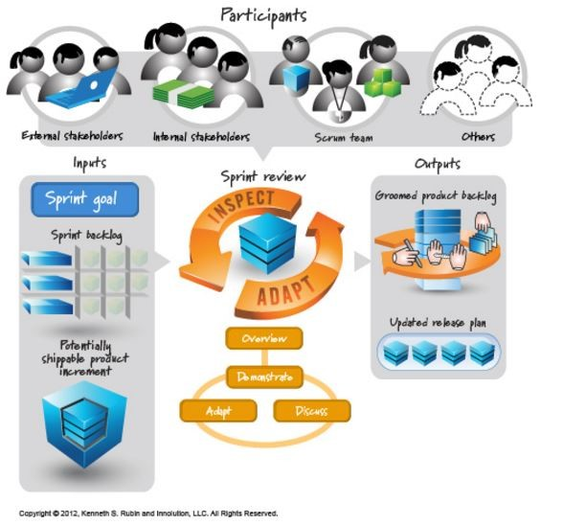
Understanding Sprint Review (ack. Ken Rubin) – as part of Scrum Events
Showcase

Slide 8
Sprint Review - 1
Informal meeting (i.e. not a Status meeting)
Showcasing within the Sprint Review is:
Intended to elicit feedback
Foster Collaboration
Time-boxed to 4 hours (for 1 month Sprints)
May be shorter for shorter sprints
Scrum Master organizes the Event
And keeps it within the Time-Box

Slide 9
Sprint Review – 2
Product Owner explains what is “Done”
The Development Team Demonstrates (Showcases) what is “Done”
And answers questions about the release
Product Owner discusses the Product Backlog
Based on “Value” of the release / product to users
Review of Time, Budget, Potential Capabilities and Marketplace for next release
Entire group Collaborates to provide input to next Sprint’s Planning

Slide 10
http://www.agilechamps.com/scrum-ceremonies-demoreview-or-showcase/
A showcase, demo or sprint review represents one and same thing. A sprint review is an informal meeting that typically takes the form of a demo of the completed features or what is accomplished during the sprint to the product owner (And rest of the team).
This can be done as and when the work is completed over waiting for last day of the sprint to arrive. This mitigates the risk of incorporating review comments which may result in sprint failure if the demo is done on the last day of the sprint.
In case if there are review comments, that should be fixed and once again demo to be conducted for the story which had review comments.
The whole team should participate. Although the team needs to get the buy-in from PO to change the story to done-done while the feedback from the whole team helps. You can invite other teams, support or customer as needed.
One of the core objectives of the demo is to review progress against the sprint goal and team commitment. It is an opportunity to get everyone on the same page in terms of what was accomplished, what’s still in progress and what tradeoffs were made.
Notes:
The following Scrum ceremonies are to be understood well.
Planning and grooming
Daily Standups
Demo/Review or Showcase
Retrospectives
Let’s talk about Demo/Review or Showcase in this article
A showcase, demo or sprint review represents one and same thing. A sprint review is an informal meeting that typically takes the form of a demo of the completed features or what is accomplished during the sprint to the product owner (And rest of the team).
This can be done as and when the work is completed over waiting for last day of the sprint to arrive. This mitigates the risk of incorporating review comments which may result in sprint failure if the demo is done on the last day of the sprint. In case if there are review comments, that should be fixed and once again demo to be conducted for the story which had review comments.
The whole team should participate. Although the team needs to get the buy-in from PO to change the story to done-done while the feedback from the whole team helps. You can invite other teams, support or customer as needed.
One of the core objectives of the demo is to review progress against the sprint goal and team commitment. It is an opportunity to get everyone on the same page in terms of what was accomplished, what’s still in progress and what tradeoffs were made.
Best practices around Demo/Showcase
Prepare, prepare and prepare – Don’t go to demo meeting and start talking randomly. Everyone’s time is important including you.
Practice before the demo – Run the workflow or the feature you have built. This ensures everything works.
Give importance to Acceptance Criteria – You can always talk about nonfunctional requirements while the focus should be on acceptance criteria. What value your feature is adding to product/business.
Follow KISS – Keep it short and simple – Don’t complicate things. Make it crisp, cover all the points written down in acceptance criteria. Give time to your team and PO to ask questions.
Showcase Value – Do not focus on technology or the feature you have built works while do talk about business value. Feel the sense of pride or accomplishment in showcasing what you accomplished.
Communication – It’s key to success. Talk to the point. Listen to people (your team). Write down their feedback and comments. The good idea is to record the meeting so that you can always go back and listen to the feedback if any.
Involve right participants/stakeholders – Not just your sprint team or PO but you should be inviting folks representing your product business. Folks on the actual ground adds lots of value to the project/product.
Seek Feedback – Accept the feedback positively. Your goal is your team success, making a product better and help the organization to get more value. This eventually helps you to grow faster.
Like2
Related
Scrum Ceremonies - Planning and GroomingMarch 25, 2017In "Agile Tutorials"
Scrum Ceremonies - Daily Stand UpsMarch 19, 2017In "Agile Tutorials"
Agile Top 10 Interview QuestionsMarch 19, 2017In "Agile Interviews"
CATEGORIESAGILE TUTORIALSTAGSBEST PRACTICES FOR DEMO OR SHOWCASE, DEMO, HOW TO DO SCRUM DEMO RIGHT, SCRUM CEREMONIES, SCRUM CEREMONIES – DEMO/REVIEW OR SHOWCASE, SHOWCASE, SPRINT REVIEW, WHAT ARE 4 SCRUM CEREMONIES, WHAT SPRINT REVIEW OR SHOWCASE OR DEMO?

Slide 11
Best Practices for Showcase http://www.agilechamps.com/scrum-ceremonies-demoreview-or-showcase/
Prepare, prepare and prepare – Don’t go to demo meeting and start talking randomly. Everyone’s time is important including you.
Practice before the demo – Run the workflow or the feature you have built. This ensures everything works.
Give importance to Acceptance Criteria – You can always talk about nonfunctional requirements while the focus should be on acceptance criteria. What value your feature is adding to product/business.
Follow KISS – Keep it short and simple – Don’t complicate things. Make it crisp, cover all the points written down in acceptance criteria. Give time to your team and PO to ask questions.
Showcase Value – Do not focus on technology or the feature you have built works while do talk about business value. Feel the sense of pride or accomplishment in showcasing what you accomplished.
Communication – It’s key to success. Talk to the point. Listen to people (your team). Write down their feedback and comments. The good idea is to record the meeting so that you can always go back and listen to the feedback if any.
Involve right participants/stakeholders – Not just your sprint team or PO but you should be inviting folks representing your product business. Folks on the actual ground adds lots of value to the project/product.
Seek Feedback – Accept the feedback positively. Your goal is your team success, making a product better and help the organization to get more value. This eventually helps you to grow faster.
Notes:
The following Scrum ceremonies are to be understood well.
Planning and grooming
Daily Standups
Demo/Review or Showcase
Retrospectives
Let’s talk about Demo/Review or Showcase in this article
A showcase, demo or sprint review represents one and same thing. A sprint review is an informal meeting that typically takes the form of a demo of the completed features or what is accomplished during the sprint to the product owner (And rest of the team).
This can be done as and when the work is completed over waiting for last day of the sprint to arrive. This mitigates the risk of incorporating review comments which may result in sprint failure if the demo is done on the last day of the sprint. In case if there are review comments, that should be fixed and once again demo to be conducted for the story which had review comments.
The whole team should participate. Although the team needs to get the buy-in from PO to change the story to done-done while the feedback from the whole team helps. You can invite other teams, support or customer as needed.
One of the core objectives of the demo is to review progress against the sprint goal and team commitment. It is an opportunity to get everyone on the same page in terms of what was accomplished, what’s still in progress and what tradeoffs were made.
Best practices around Demo/Showcase
Prepare, prepare and prepare – Don’t go to demo meeting and start talking randomly. Everyone’s time is important including you.
Practice before the demo – Run the workflow or the feature you have built. This ensures everything works.
Give importance to Acceptance Criteria – You can always talk about nonfunctional requirements while the focus should be on acceptance criteria. What value your feature is adding to product/business.
Follow KISS – Keep it short and simple – Don’t complicate things. Make it crisp, cover all the points written down in acceptance criteria. Give time to your team and PO to ask questions.
Showcase Value – Do not focus on technology or the feature you have built works while do talk about business value. Feel the sense of pride or accomplishment in showcasing what you accomplished.
Communication – It’s key to success. Talk to the point. Listen to people (your team). Write down their feedback and comments. The good idea is to record the meeting so that you can always go back and listen to the feedback if any.
Involve right participants/stakeholders – Not just your sprint team or PO but you should be inviting folks representing your product business. Folks on the actual ground adds lots of value to the project/product.
Seek Feedback – Accept the feedback positively. Your goal is your team success, making a product better and help the organization to get more value. This eventually helps you to grow faster.
Like2
Related
Scrum Ceremonies - Planning and GroomingMarch 25, 2017In "Agile Tutorials"
Scrum Ceremonies - Daily Stand UpsMarch 19, 2017In "Agile Tutorials"
Agile Top 10 Interview QuestionsMarch 19, 2017In "Agile Interviews"
CATEGORIESAGILE TUTORIALSTAGSBEST PRACTICES FOR DEMO OR SHOWCASE, DEMO, HOW TO DO SCRUM DEMO RIGHT, SCRUM CEREMONIES, SCRUM CEREMONIES – DEMO/REVIEW OR SHOWCASE, SHOWCASE, SPRINT REVIEW, WHAT ARE 4 SCRUM CEREMONIES, WHAT SPRINT REVIEW OR SHOWCASE OR DEMO?

Slide 12
Sub-Module Retrospective
An Agile Practice
© MethodScience; Material Designed and Presented by Dr. B. Unhelkar; drawn from The Art of Agile Practice

Slide 13
Retrospective-1: What is it?
An Agile/Scrum Practice of introspection
Purpose (Page 14 of Scrum Guide):
Inspect how the last Sprint went with regards to People, Relationships, Process and Tools
Identify and order the major items that went well and potential improvements;
Create a plan for implementing improvements to the way the Scrum Team does its work

Slide 14
Retrospective-2: Introspection for Continuous Improvement
Scrum Team inspects & adapts itself in order to improve the way it works in a Sprint
Sprint Retrospective:
Occurs AFTER the Sprint Review and BEFORE the Sprint Planning for the Next Sprint
Time-boxed to 3 hours for 1-month Sprints (Can be shorter for shorter sprints)
Scrum Master organizes this event
Explains the attendees its purpose
Maintains the time-box of 3 hours

Slide 15
Retrospective-3: Scrum Master
Plays an important role of Servant-Leader
Encourages the Scrum Team to improve its practices to make them more effective and enjoyable for the next Sprint
The Scrum Team plans ways to increase product quality by improving work processes
Also adapts the definition of “Done” if appropriate and not in conflict with product or organizational standards

Slide 16
http://www.agilechamps.com/scrum-ceremonies-retrospectives/
No matter how great your team is, there is always scope to improve and get better. The retrospective is a way to accomplish this periodically.
The main focus is to look at what is working and what is not?
What are the action items we have based on our learning?
The core focus of retrospective is a continuous improvement which is one of the core philosophy of agile.
Notes:
Let’s talk about agile retrospective in this article
No matter how great your team is, there is always scope to improve and get better. The retrospective is a way to accomplish this periodically. The main focus is to look at what is working and what is not? Further, what are the action items we have based on our learning? The core focus of retrospective is a continuous improvement which is one of the core philosophy of agile.
The primary agenda of this meeting where every team member is expected to bring their points are
What worked well?
What did not work well?
Action items to improve the process (Mainly action items are result of what did not work well)
How to do it
Set the stage. Invite entire team to a meeting (Scrum Master, Product Owner, Team and Customer if possible)
Give 10 minutes for everyone to enter their points towards 3 agenda items stated above. The recommendation is to use a tool (For instance noteapp) and send this to the whole team in advance to enter their points. This would save time for a team in meeting and moreover give enough time to team members to think and state their points.
Start with talking about previous retrospectives action items. Close the items which are accomplished.
Talk about what worked well, appreciate people and motivate the team to continue utilizing the best practices.
Discuss what did not work well and come with action items
Assign owners to every action item.
Close the retrospective while action items to go to action item register.
Best Practices
Typically it should happen after every sprint and should last between 30 to 60 minutes.
The whole team should participate.
This can be considered as “lesson learned” meeting. The notes can go to organizational process assets (Remember “PAL” or “Process Asset Library”).
The owners must be assigned to action items. The next retrospective should start with open items of previous retrospective meetings. I have seen, individual teams have excellent ideas while post retrospective nobody really thinks about it.
One of the recommendation is to have a retrospective of retrospectives to make it better.
Don’t point fingers instead work as a team and support each other.
Do not forget to appreciate your team members.

Slide 17
Retrospective Agenda http://www.agilechamps.com/scrum-ceremonies-retrospectives
The primary agenda of this meeting where every team member is expected to bring their points are
What worked well?
What did not work well?
Action items to improve the process (Mainly action items are result of what did not work well)

Slide 18
How to do it
Set the stage. Invite entire team to a meeting (Scrum Master, Product Owner, Team and Customer if possible)
Give 10 minutes for everyone to enter their points towards 3 agenda items stated above. The recommendation is to use a tool (For instance noteapp) and send this to the whole team in advance to enter their points. This would save time for a team in meeting and moreover give enough time to team members to think and state their points.
Start with talking about previous retrospectives action items. Close the items which are accomplished.
Talk about what worked well, appreciate people and motivate the team to continue utilizing the best practices.
Discuss what did not work well and come with action items
Assign owners to every action item.
Close the retrospective while action items to go to action item register.

Slide 19
Sub-Module Agile Job Aids No.10 and 11
© MethodScience; Material Designed and Presented by Dr. B. Unhelkar

Slide 20



Showcasing
10
Job Card
WHAT: A demonstration of the Progress to Product Owner; Work through issues
WHEN: Post Iteration/Sprint, during a Showcase meeting;
HOW: Demonstrate DONE items (executables); Discuss roadblocks; Update Priorities, Estimates
METRIC: 4 hours Time boxed;
CAVEAT: Demonstrating INCOMPLETE items (e.g. PPT demos, not allowed)
Showcasing
Demonstration of Progress
© www.MethodScience.com/JobAids
version 3.0
Checkout the short Video Update
Notes:
September 19, 2018
(c) Thomson Publishing, 2005: Practical OO Design: Figures - Chapter 8 - Implementation© MethodScience, 2001-05, All Rights Reserved
www.MethodScience.com
Page: 20

Slide 21
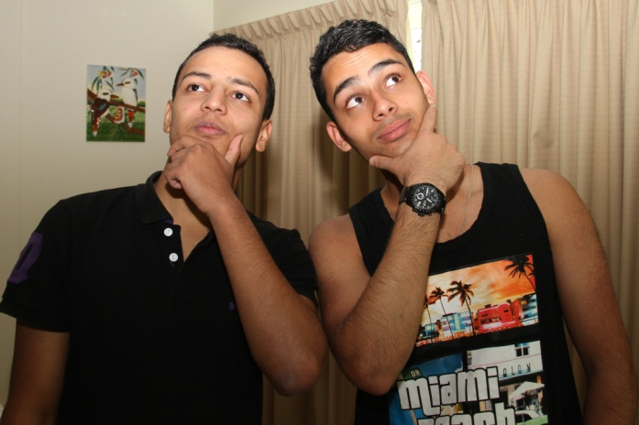
Retrospective (Post Iteration)
11
Job Card
WHAT: Meeting Feedback on an Iteration/ project for Team Members (Pigs)
WHEN: At the end of an Iteration (or a Project)
HOW: Each Team member to lists What worked/Did not work Well/ To be changed; Facilitated by Scrum Master/ Agile Coach
METRICS: 3 hours; Total Items / Retrospective;
CAVEAT: Not Documenting Post Implementation Discussion; No reuse;
Retrospectives
Reflection on Iteration
© www.MethodScience.com/JobAids
version 3.0
Checkout the short Video Update

Slide 22


Slide 23
Conclusions & Future Directions
We discussed…??
Do you see what we see?

